Slide 1
Predicting Inbound Tourist Revenue
in South Korea:
An Ensemble Modeling Approach
2023036299 김진욱
2023076508 박준호
2023094275 조준형

Slide 2
Contents
Purpose of topic selection
Variable Definition and Data Sources
Procedure
Result
Q & A

Slide 3
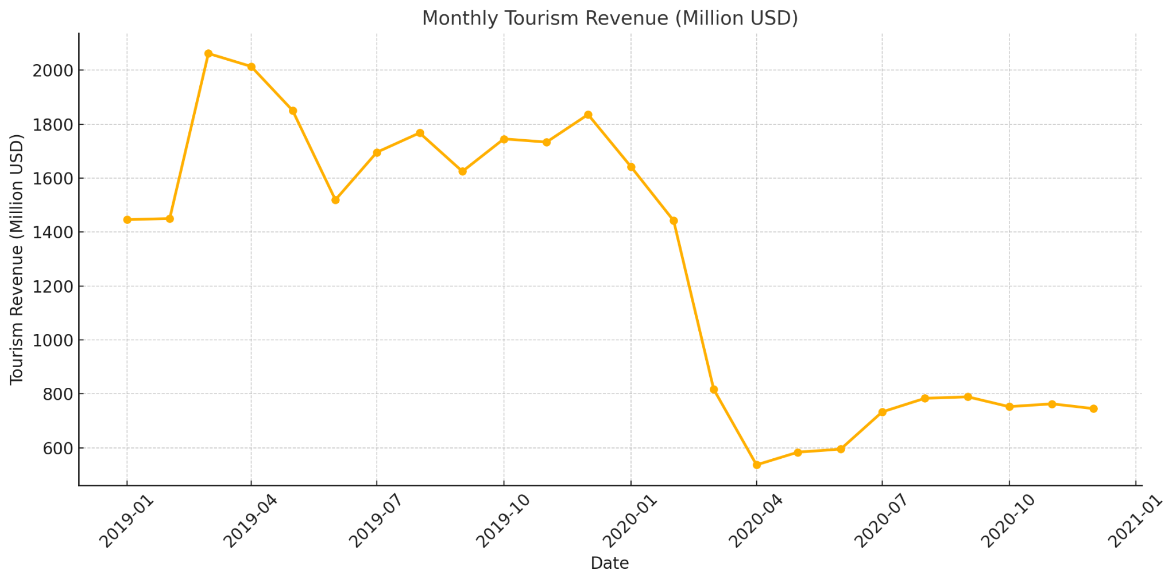
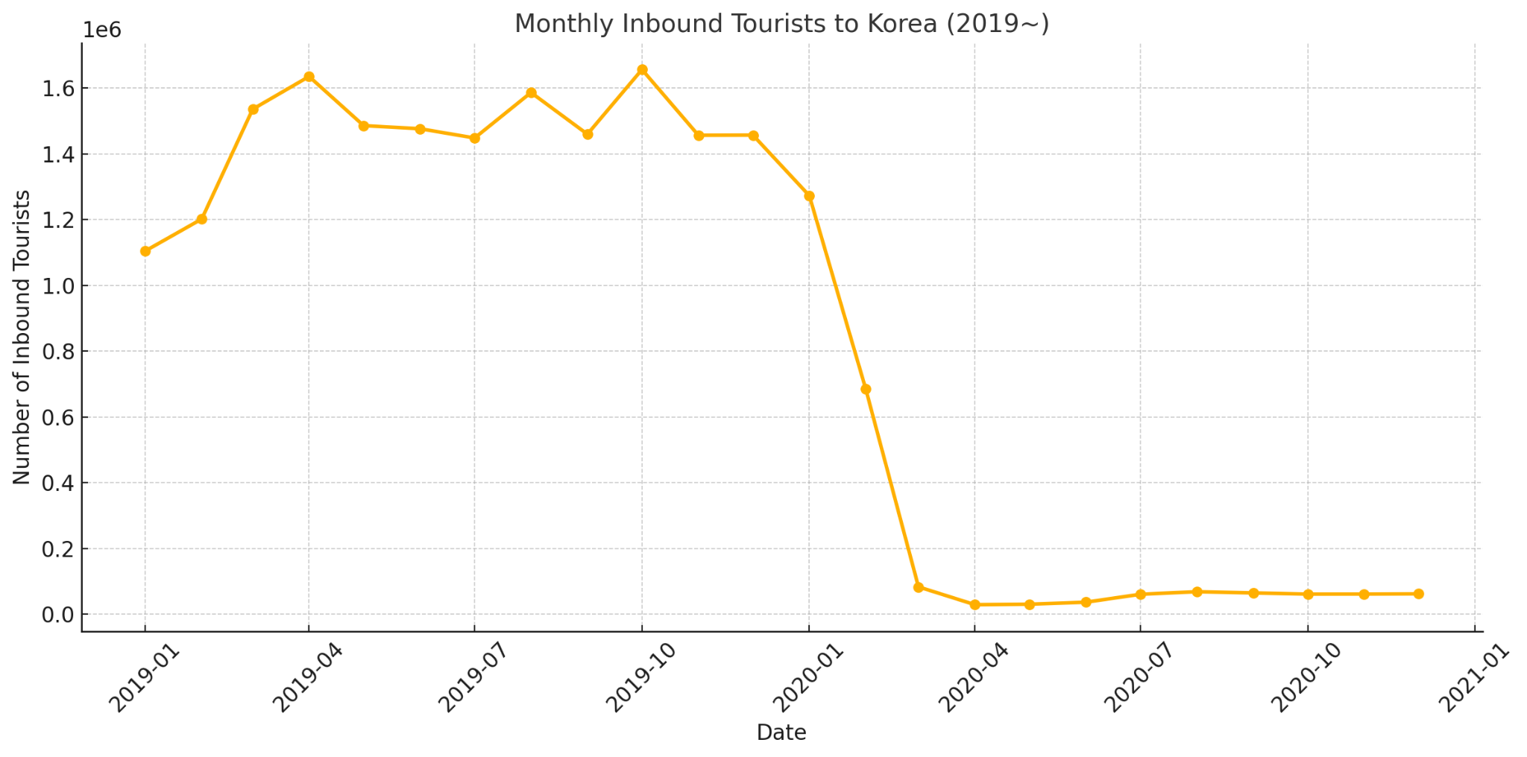
Purpose of Topic Selection
Due to COVID-19 pandemic, the tourism industry and the national economy suffered significant damage.
Result : Lower Employment, higher unemployment rate
Aim : Create a strategy prevents prediction against economic damage

Slide 4
Variable Definition and Data Sources
Independant variables : more than 20 criterion
Dependant variable : Touristic Revenue (recorded monthly in units of one thousand dollars.)
Data Sources
: FRED, 기상청, 관세청, 열린 데이터광장, SEDAILY, 한국 관광 데이터랩, 통계청 등
- The period of analyzed data : 2015.01 ~ 2024.12 (total 10 years)
Main variables
- Number of foreign visitors to South Korea
- Number of arrival flight to Incheon Airport
- Amount spent by foreigners at duty-free shops
- Average temperature and precipitation
- Exchange rate with USD and KRW
- Google Trends

Slide 5
Main Variables | Data Source
Monthly average temperature and precipitation in Korea | 기상청
Exchange_Rate_USD_KRW | FRED
Tourism_Revenue_1K_USD | 관광지식정보시스템
Payment system for foreign visitors | 관세청(공공데이터포털)
Transportation(Seoul-metro) | 서울 열린데이터광장
number of arrival flight to Incheon Airport | 인천국제공항공사(시계열)
More details
* For checking how often certain words(‘South Korea’, ’Seoul’) were searched, use Google_Trend
by some countries.
* We took a criterion Transportation by subway, because 36.8% of foreign visitors stay in 4~7 days.

Slide 6
How to treat the variable “COVID-19”(2020~2022)
COVID-19 period (2020–2022)
encoded as binary variable : ‘Pandemic’
>> Model captures revenue differences
between pandemic and non-pandemic periods

Slide 7
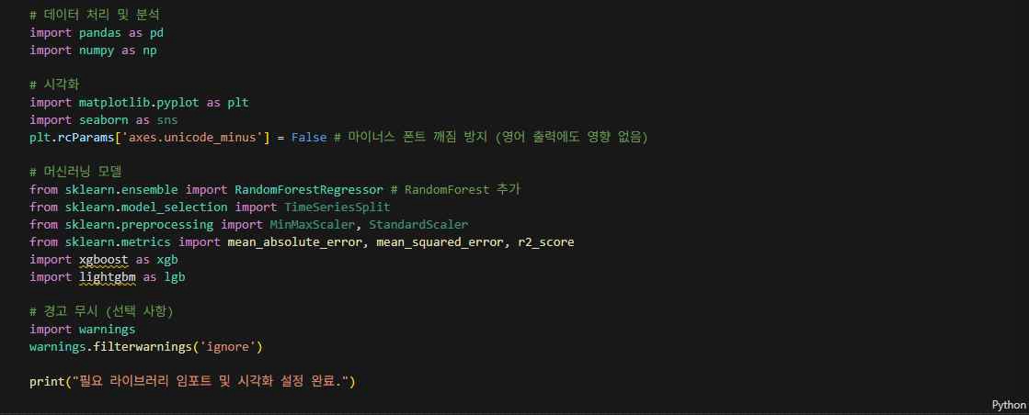
Procedure - import library

Slide 8
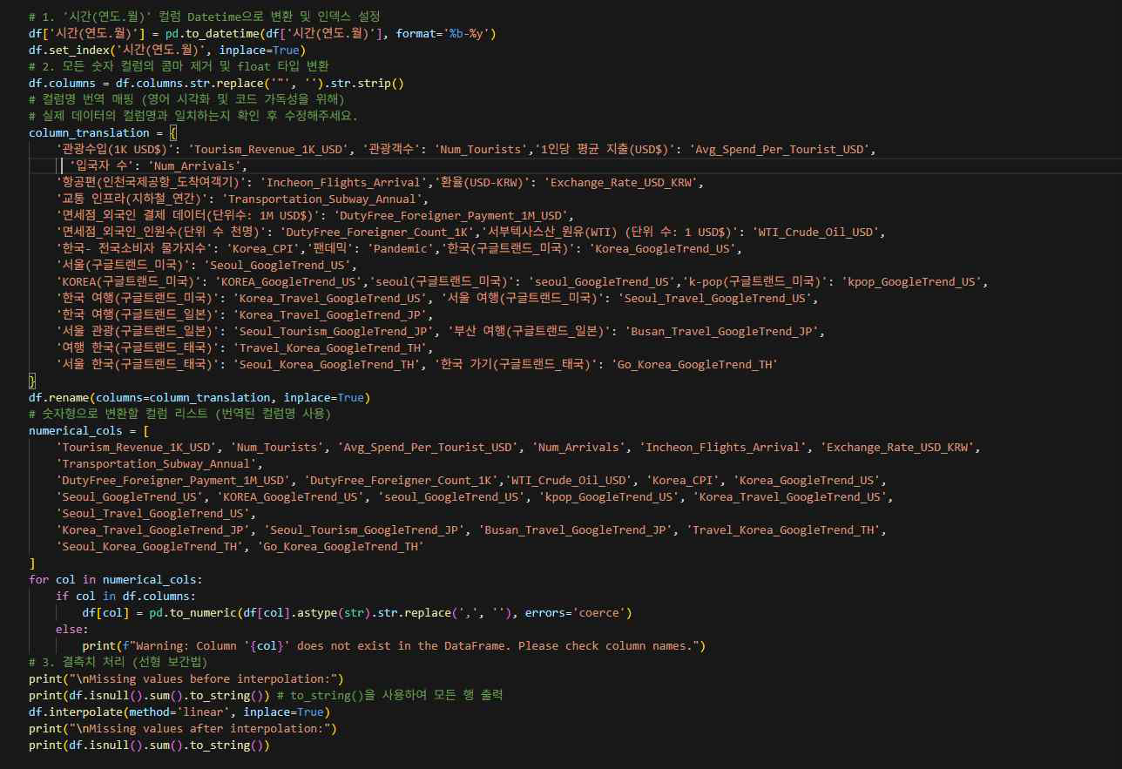
Data preprocessing
By categorizing variables on data attributes
Weather information was changed to time series format
Column names in Korean were renamed to English
All numerical variables were converted to float type
Missing values were handled using linear interpolation

Slide 9
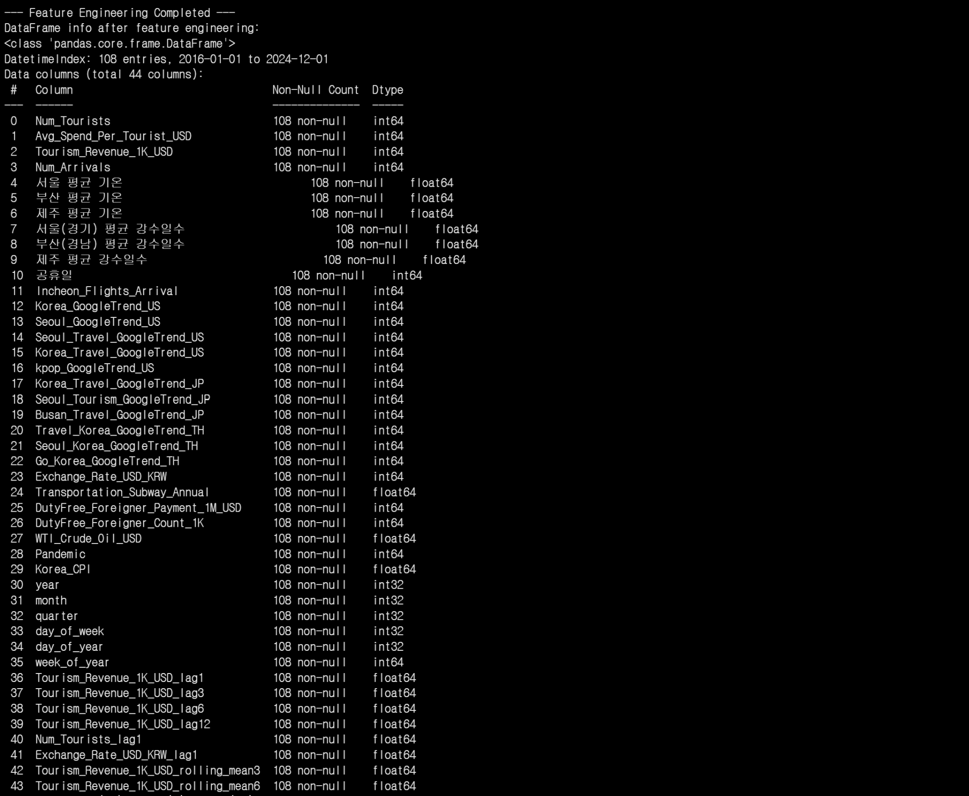
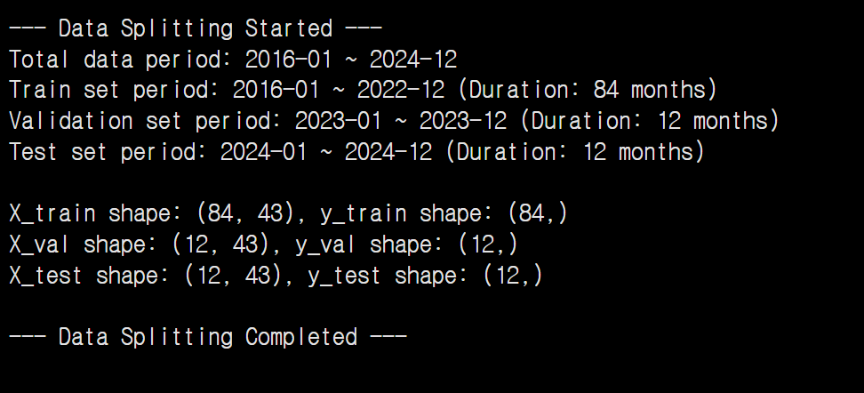
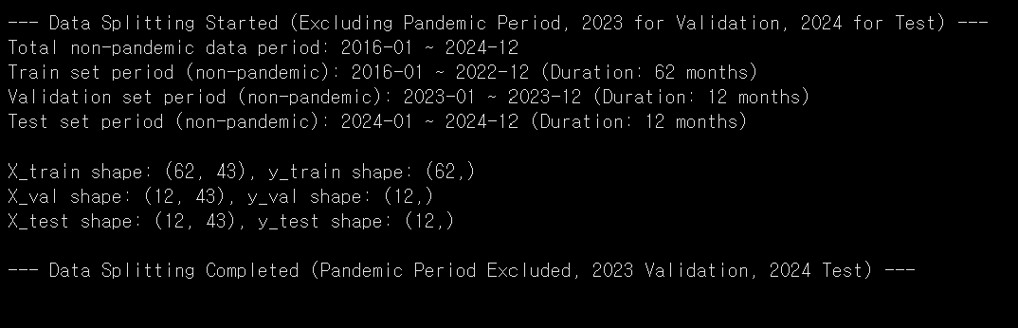
Feature Engineering & Data Splitting

Slide 10
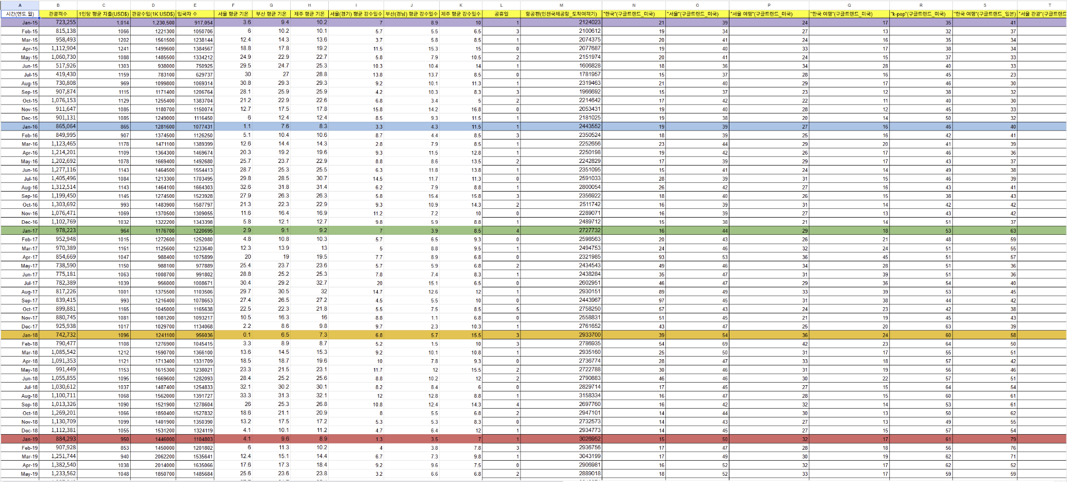
Model Selection
Complex Interactions of Diverse Factors
Using Ensemble
Ensuring Prediction Stability & Robustness
Handling High-Dimensional Data and Providing Insights

Slide 11
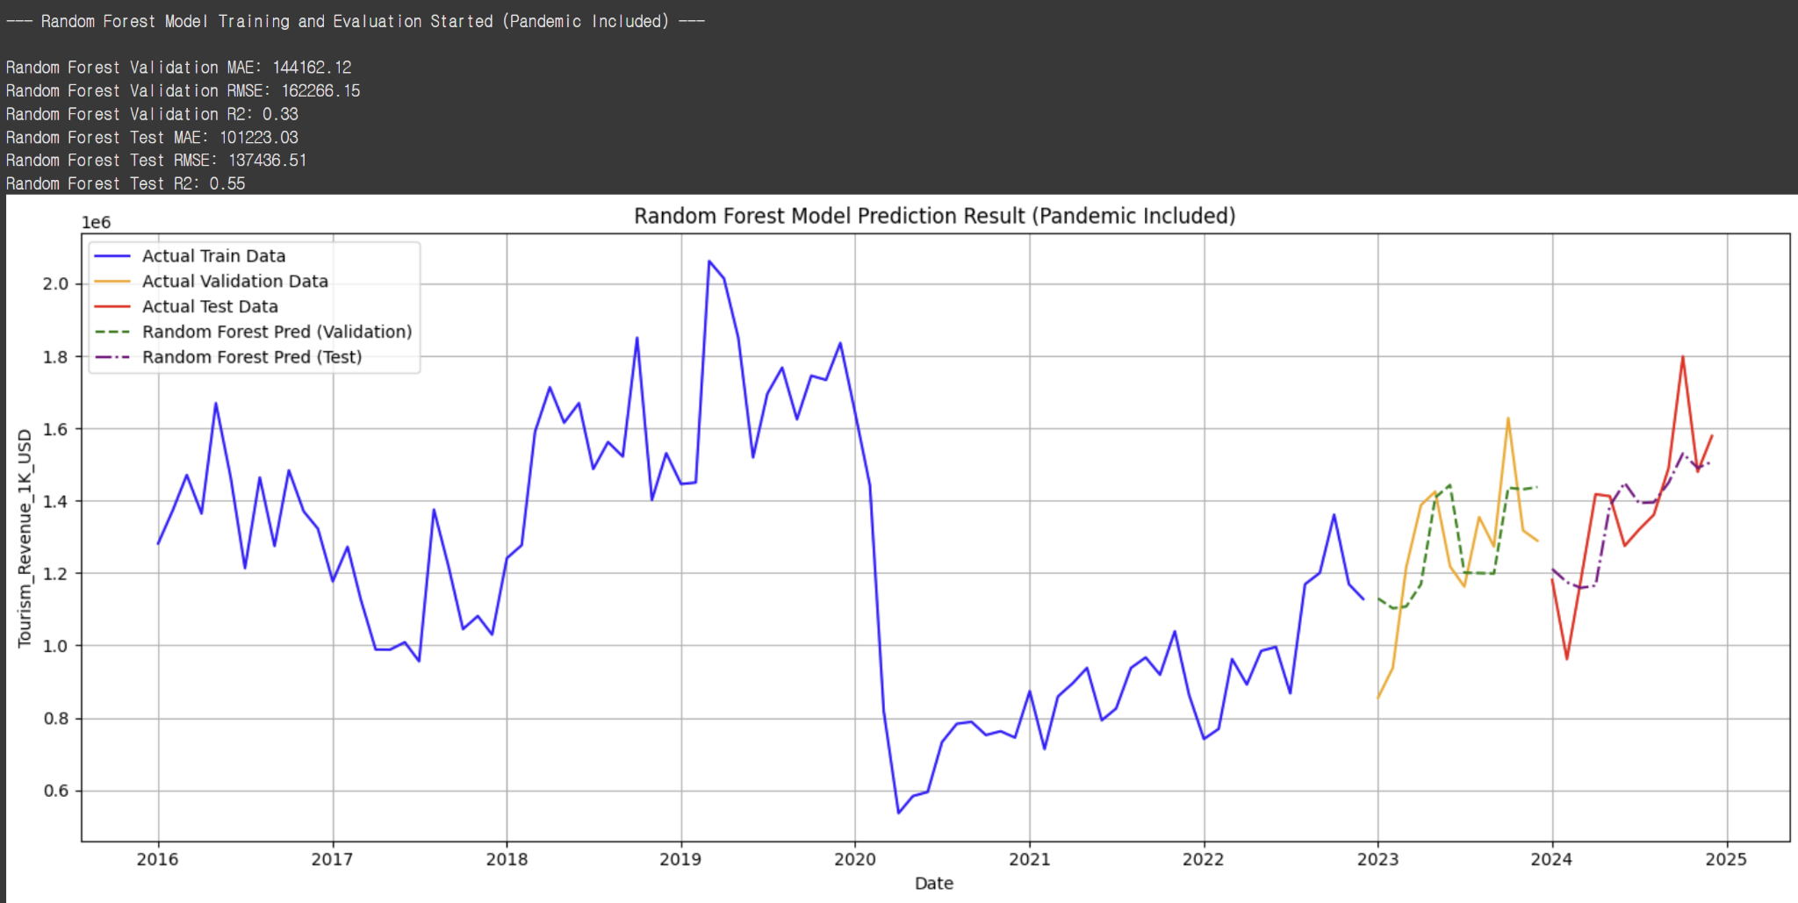
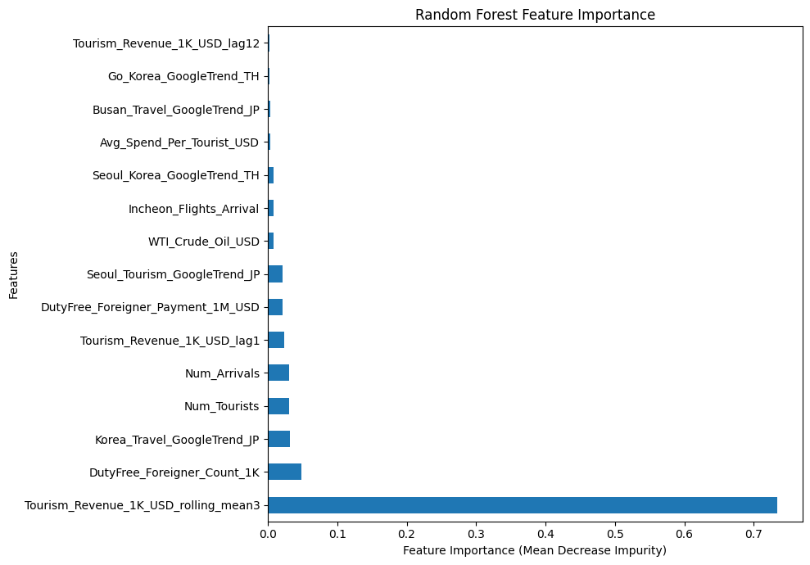
RandomForest(include COVID-19)

Slide 12
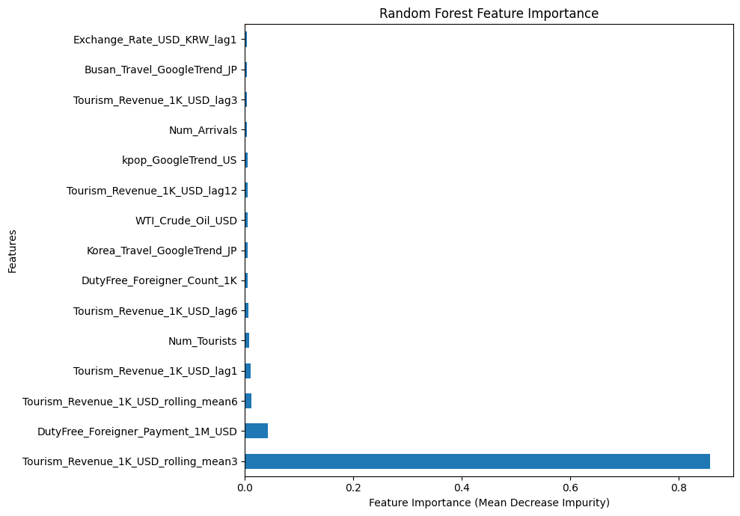
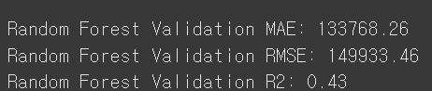
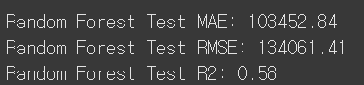
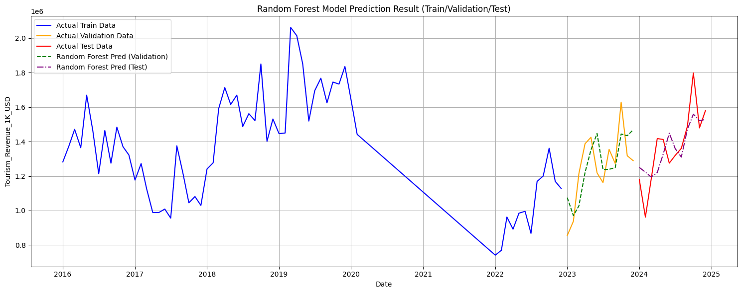
RandomForest(without COVID-19)

Slide 13
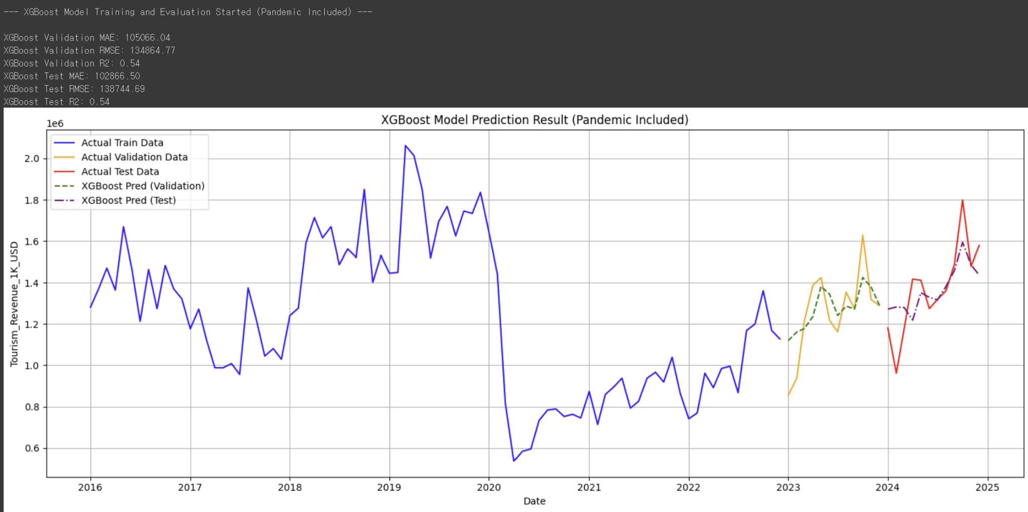
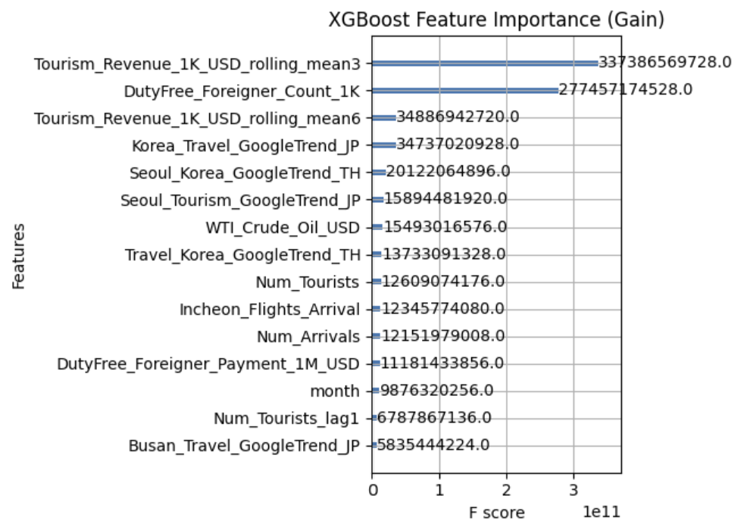
XGBOOST(include COVID-19)

Slide 14
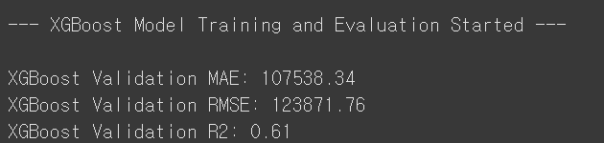
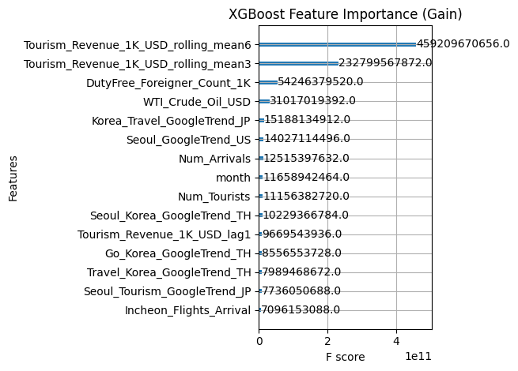
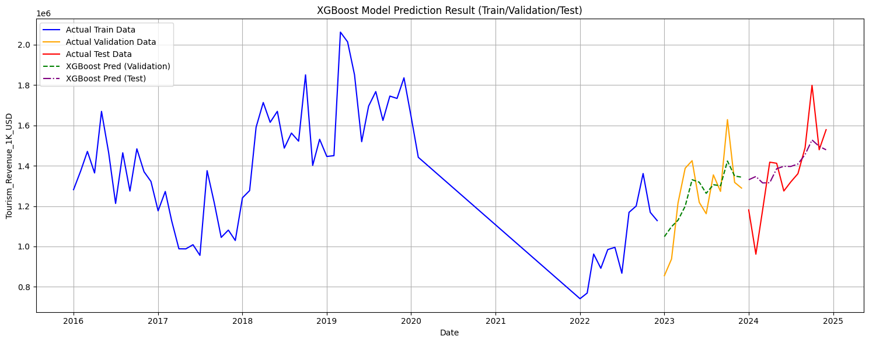
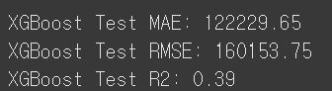
XGBOOST(without COVID-19)

Slide 15
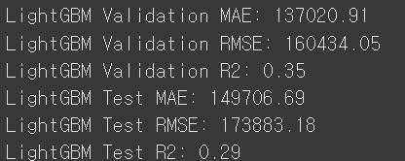
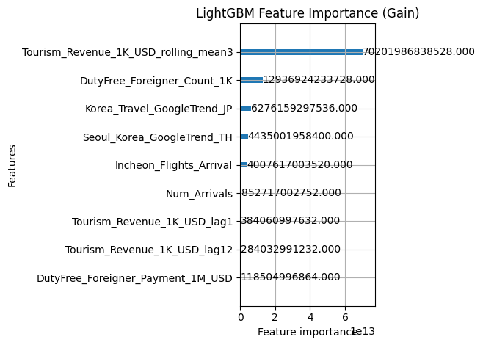
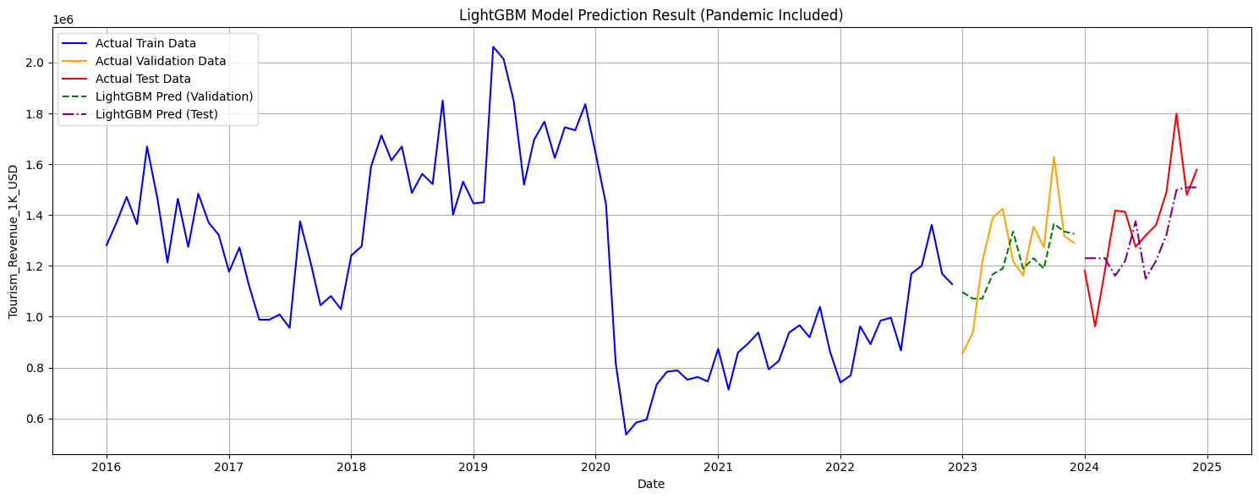
LightGBM(include COVID-19)

Slide 16
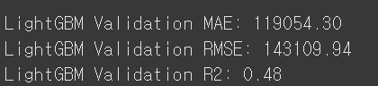

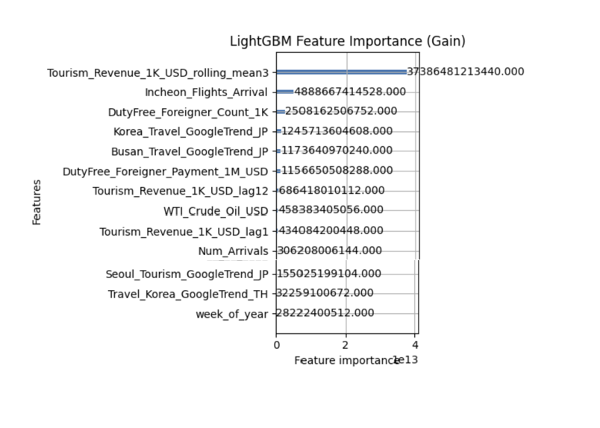
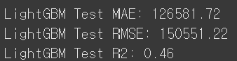
LightGBM(without COVID-19)

Slide 17
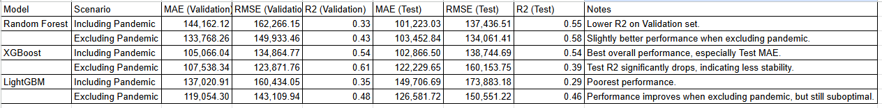
Report
result
Improvements
Data Scarcity & Distortion
Temporal Ignorance
Missing External Triggers
Beyond Obvious Drivers

Slide 18
Thank you For your Attention

